Slide 1

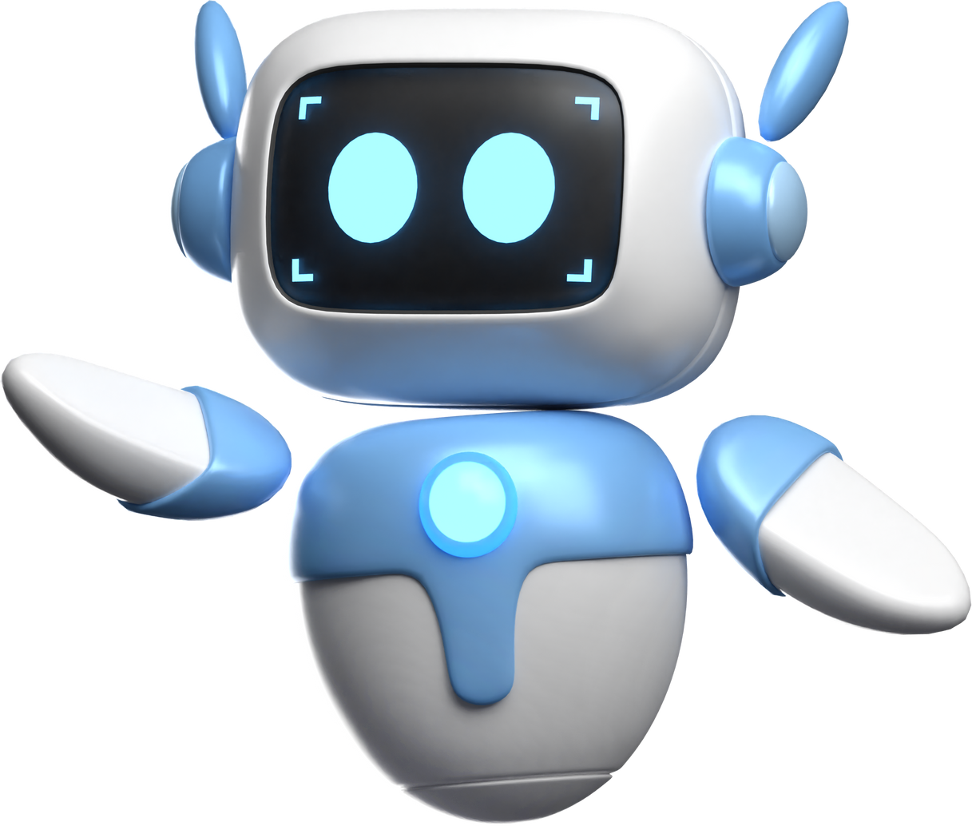
FACIAL POSE ESTIMATION
Integration of Dlib, MediaPipe, and SVM Regressors for Head Pose Estimation

Slide 2
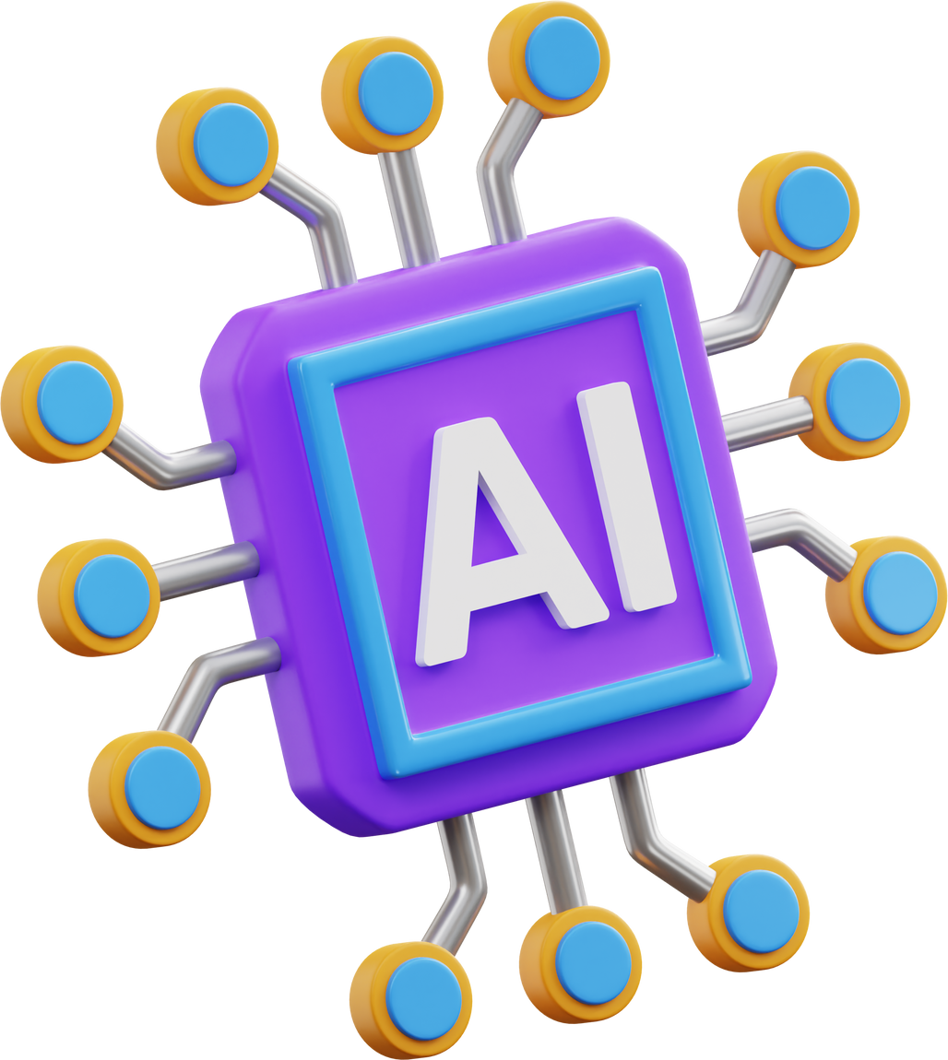
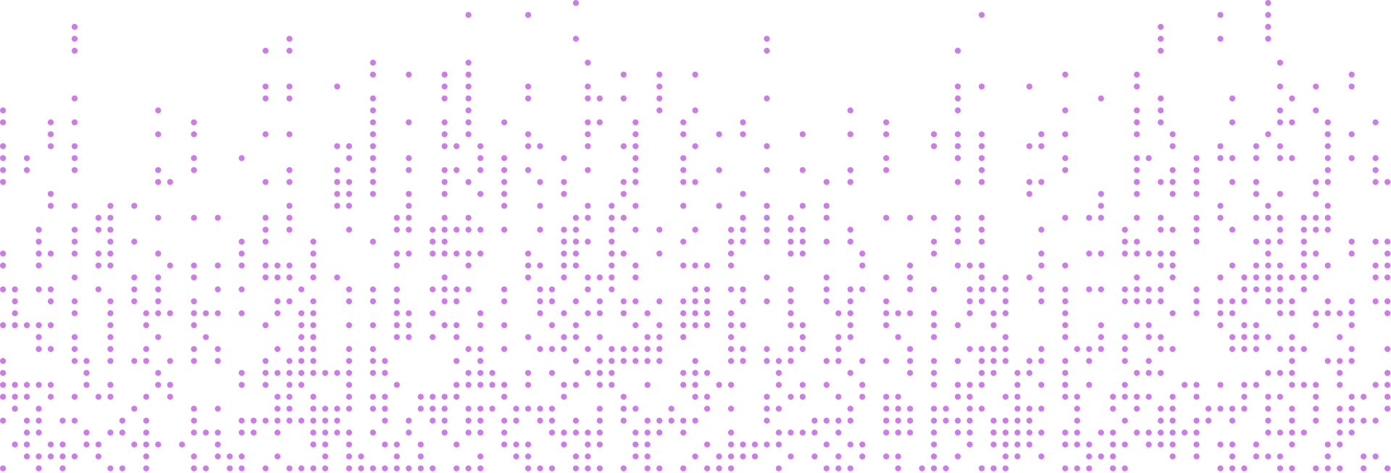

OVERVEIW
1
Facial pose estimation is crucial for various applications such as facial recognition, augmented reality, and driver monitoring systems.
2
This project focuses on predicting facial pose angles (Pitch, Yaw, Roll) using Support Vector Machines (SVM) trained on Dlib-extracted landmarks.

Slide 3

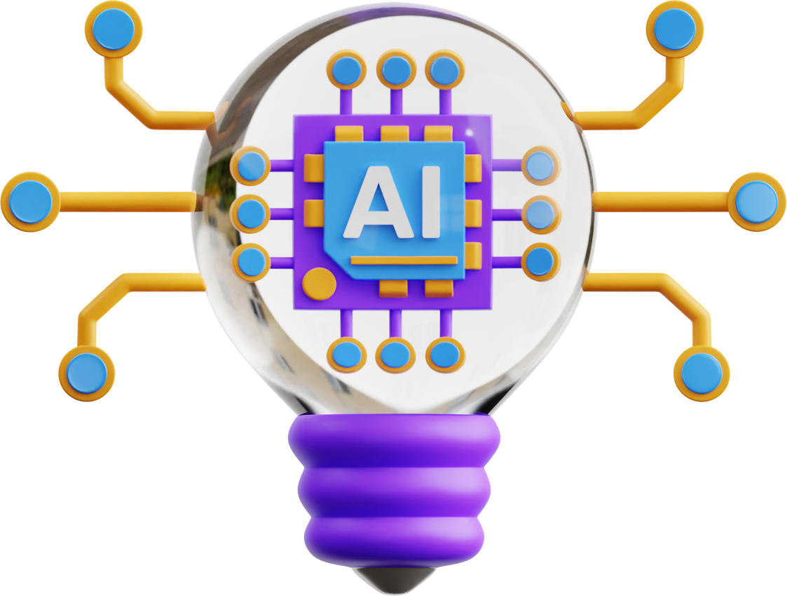
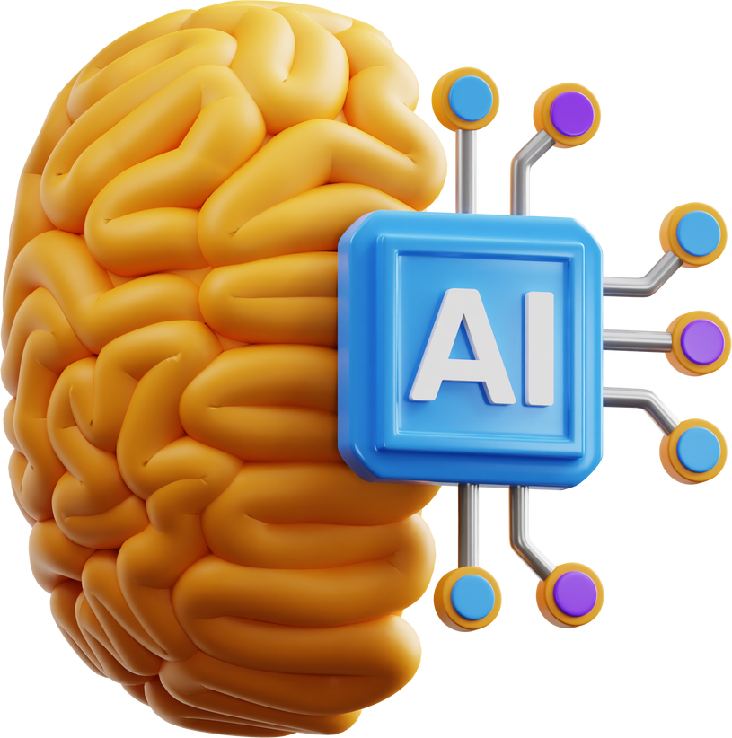
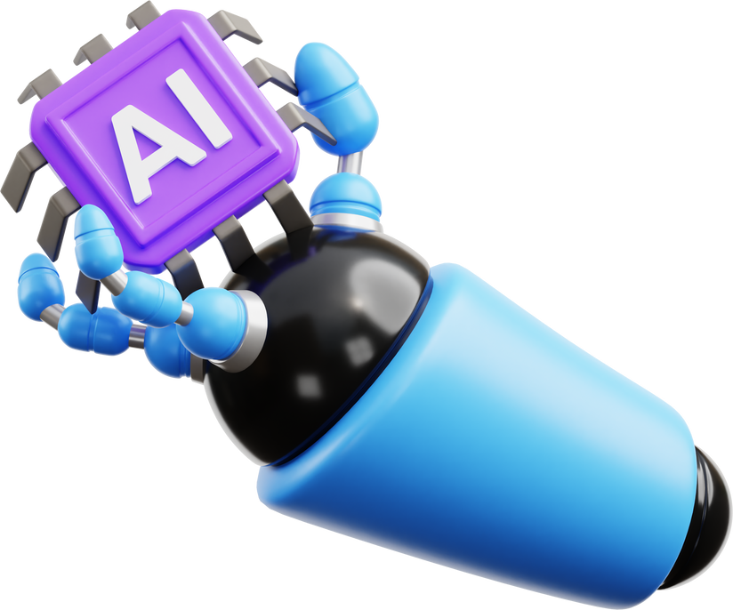
Key Goals
01
02
03
04
Extract facial landmarks from images using Dlib.
Train SVM Regressors to predict Pitch, Yaw, and Roll.
Visualize and evaluate the model's performance.
Integrate the model with MediaPipe for real-time head pose estimation.

Slide 4


TECHNOLOGIES USED
Python: Programming language for implementation.
Dlib: For facial landmark detection.
MediaPipe: For 3D face mesh generation.
OpenCV: For image and video processing.
scikit-learn: For implementing SVM Regressors.
Matplotlib: For visualization and plotting.
Joblib: For saving and loading trained models.

Slide 5
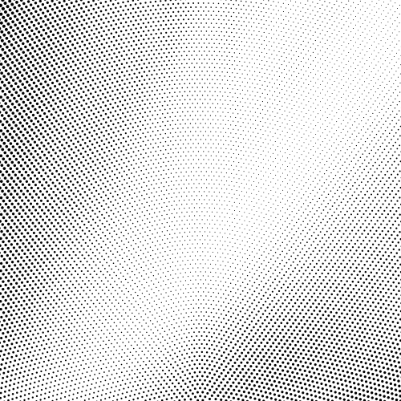

Data Preparation
Dataset
Feature Extraction
Images and corresponding .mat files containing ground truth pose parameters.
Facial landmarks extracted using Dlib's shape_predictor.
Landmarks flattened into 1D arrays as input features for SVM.

Slide 6
Data Preparation
Labels
Ground truth pitch, yaw, and roll values extracted from .mat files.

Slide 7


SVM Model Training process
Split data into training and testing sets.
Train separate SVM models for each angle (Pitch, Yaw, Roll).
Evaluate model performance using Mean Squared Error (MSE).

Slide 8




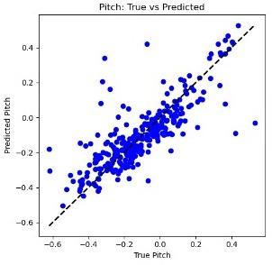
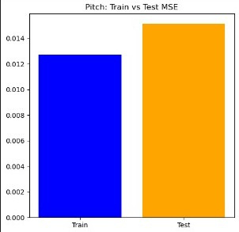

Results of Pitch

Slide 9
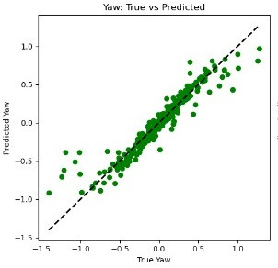
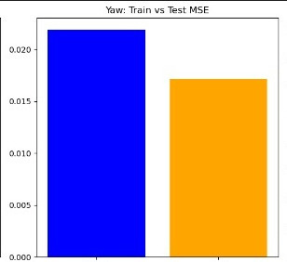
Results of Yaw

Slide 10
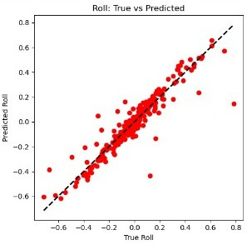
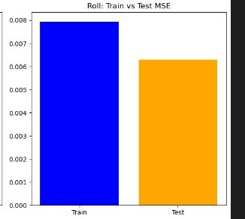
Results of Roll

Slide 11

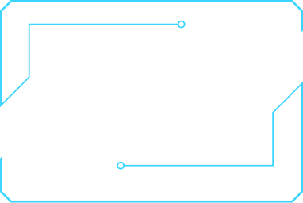


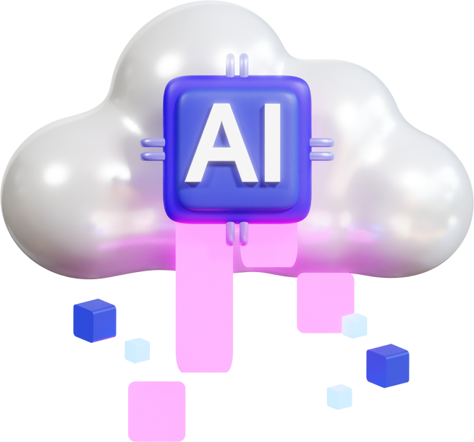
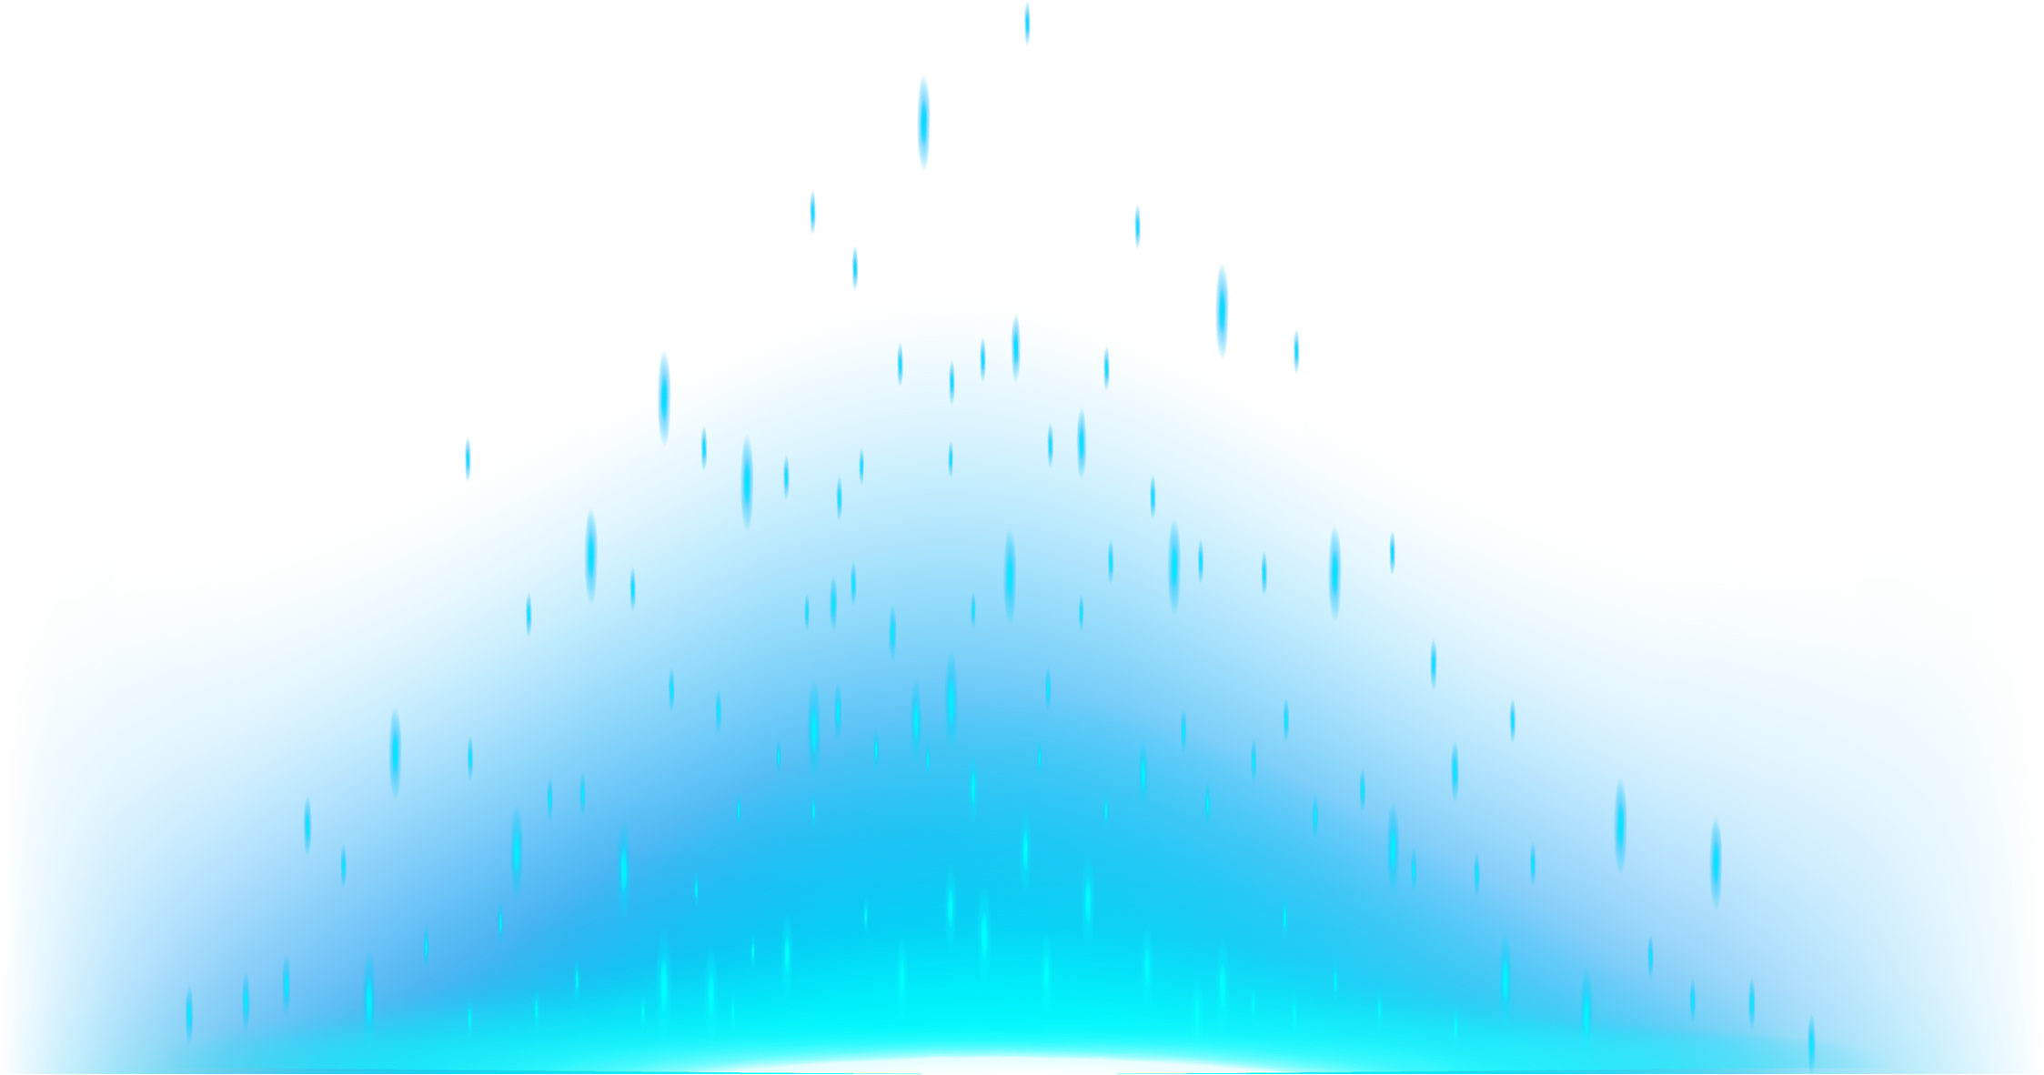

Demo
LIVE DEMONSTRATION
Run the application on a sample image and video.
Show real-time prediction and visualization of facial pose.

Slide 12
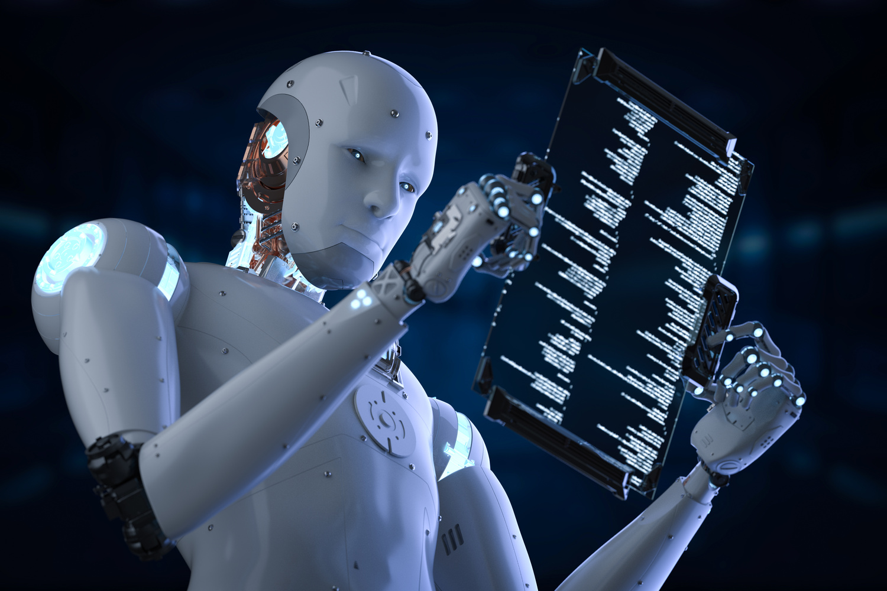
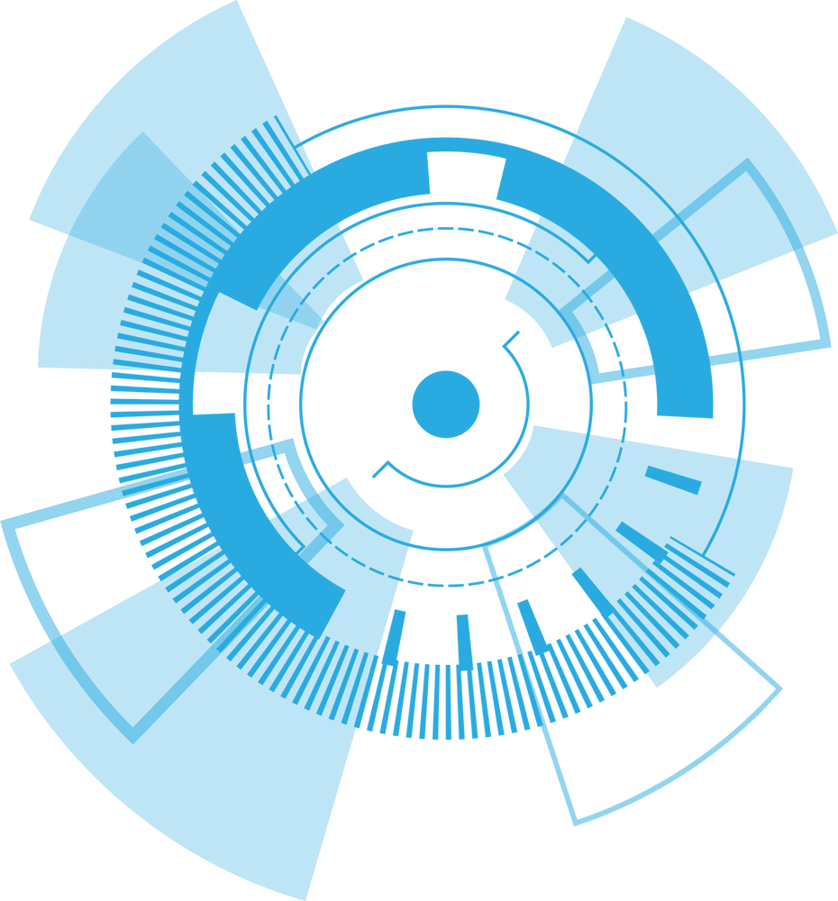
conclusion
Summary:
Successful implementation of a facial pose estimation system using SVM and Dlib.
Integration with MediaPipe enhances the model’s real-time capabilities.
Future Work:
Further improvements on accuracy.
Expansion to handle more complex facial expressions and multiple faces.

Slide 13
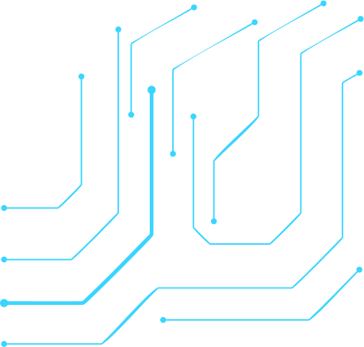

Thank You!
Github repository

